Slide 1
Introduction to Big Data
Modeling the Analytic Problem

Slide 2
Review Previous Lesson

Slide 3
Review Concepts from Day 1
The following major topics were introduced last class.
Big Data
Data Analytics
Business Questions
Big Data and Analytics
Analytical Models
Statistical Methods
Python Jupyter Notebooks

Slide 4
Lesson Review from Day 1
The following questions provide a review from last class.
Describe the key components to transform data into business value
Describe how Big Data is different from traditional Small Data
Identify some of the historical events since the year 2000 that have catalysts for the Big Data era
Differentiate data from information
Explain the major purposes of analytics
Describe how business problems need to be translated and framed to take advantage of analytics including the essential components of a framed problem
Describe how data analytics relates to business performance management
Describe the main role of statistics in describing data
Describe the main set of analytics capabilities that are in common use

Slide 5
Day 2 – New Topics Introduced
The following major topics are introduced this Day.
Business Problem Definition
Analytics Problem Definition
Influence Diagramming
Stakeholder & Analytics Teams
Data Characteristics
Data Structure
Data Format
Data Granularity
Data Latency
Data Security
Variable Types
Data Visualization Basics

Slide 6
Learning Objectives for Day 2

Slide 7
Day 2 - Learning Objectives
During Day 2 you will learn to:
Translate a business problem into an analytics problem statement that defines purpose, scope and requirements of a proposed analytical model.
Describe a proposed solution to the analytics problem statement in terms of stakeholders and team management.
Further differentiate Big Data from Small Data in terms of key characteristics including structure, format, granularity, latency and security requirements
Describe different types of variables encountered in measurement
Describe some basic concepts about data visualizations
Apply and use a Python Jupyter Notebook

Slide 8
Business Problem Statement

Slide 9
Business Problem Statement
Business problems must be well framed before analytics can be applied
The problem must be understood in terms of input and output variables
Problems may be either:
Already well defined and clearly understood
Problem symptom (s) are clearly known and described by an output variable
Decision variables are well known and understood
Assumptions are consistent
Other input variables (parameters) are well known
Poorly defined and not well understood
The actual problem symptom must be discovered and related to an output variable that is understood
Decision variables must be discovered and evaluated
Assumption variables must be aligned with different points of view
Other relevant input variables (parameters) must be discovered and validated.

Slide 10

The era of big data in science
The great empiricists of the 17th century believed that if we used our senses to collect as much data as possible, we would ultimately understand our world.
Although empirical science has a long history, there are some key differences between a traditional approach and the data-driven science we do today.
The change that has perhaps had the most impact is the sheer amount of data that computers can now collect.
This has enabled a change in philosophy: data can be gathered to serve many projects rather than just one, and the way we explore and mine data allows us to “plan for serendipity”.
“To be ignorant of causes is to be frustrated in action.”
—Francis Bacon

Slide 11
Business Problems Framing Process
Characteristics of
Un-Framed
Business Problems
Unclear
Ambiguous
Qualitative
Multiple Symptoms
Unknown Drivers
Characteristics of
Framed
Business Problems
Defined Outcome Variable(s)
Defined Decision Variable(s)
Defined Parameter Variable(s)
Rationale for Solving It
Clear Description
Framing
Process

Slide 12
Business Problem Example
A pizza restaurant is facing new competition from the recent opening of more dining options in its neighborhood.
The average number of daily customers has started to slowly decline over the past 12 months. The monthly average revenue has also started to decline.
Lets assume that the problem symptom is framed as “Margin” level. The symptom will be reduced if the “Margin” can be raised to a desired level Margin is defined as Monthly Revenue minus Month Expenses.
Decision variables that influence margin are price per pizza sold, number of pizza’s sold and various types of operating expenses.
Parameter variables include local demographic data such as population size and income levels
Note that the Margin level was chosen as the framed problem output variable instead of customer count and quantity of pizza’s sold.

Slide 13
Business Problems – Next Step
Problem Framing concludes with:
Outcome (output) variables
Input variables
Decision variables
Parameter variables
Description of the problem and why it is important to solve
The next step determines how the input variables are related to the output variables.
This is called the Analytics Problem Statement

Slide 14
Analytics Problem Statement

Slide 15
Analytics Problem Statement
From Business Problem to Analytics Problem
Framed
Business Problems
Outcome Variable(s)
Decision Variable(s)
Parameter Variable(s)
Rationale for Solution
Clear Description & Context
Analytics Problem
Definition
Output Variables
Input Variables
Intermediate Variables
Variable Data Types
Variable Data Ranges
Key Relationships
Relationship Types
Model Structure
Analytics
Problem
Definition
Process

Slide 16
Analytics Problem Statement
Major Components of an Analytics Problem Statement
Component | Purpose | Description
Output Variables | Calculated by an analytics model | Measures improvement or problem resolution
Input Variables | Provided as input to the model | Includes constants, decision variables and estimated parameters
Intermediate Variables | Calculated internally by the model | Provides additional information to the decision maker
Variable Data Types | Determines how the model can process them | Variables are either qualitative (descriptive) or quantitative (measures)
Relationship | The logic that transforms inputs into outputs | Expressed as rules, formulae or algorithms
Analytics Approach | Classifies the type of model to be built | Diagnostic, Descriptive, Predictive or Prescriptive

Slide 17
Influence Diagramming

Slide 18
Influence Diagramming
Influence diagrams allow you to create a logical diagram that describes your current understanding of the analytics problem. It uses a graphical technique to define the key variables and how they influence each other. This is an iterative process and it evolves as your understanding of the analytics problem becomes more clear.
There are 4 types of variables in an influence diagram
Outcome variables
Decision variables
Parameter variables
Intermediate variables
The variables are connected by an “influence” line
This technique enables you to identify
Key variables
Expected relationships between variables
When the analytics solution is eventually designed each “influence” line identifies the need for a formula, heuristic or algorithm.

Slide 19
Influence Diagramming Symbols
Outcome variable calculated by the model
Decision variable input to the model
Parameter variable input to the model
Intermediate variable calculate by the model

Slide 20
Influence Diagramming Symbols
product
price
revenue
sales prospects
units
sold
margin
sales visits
sales
commission
budget
cost

Slide 21
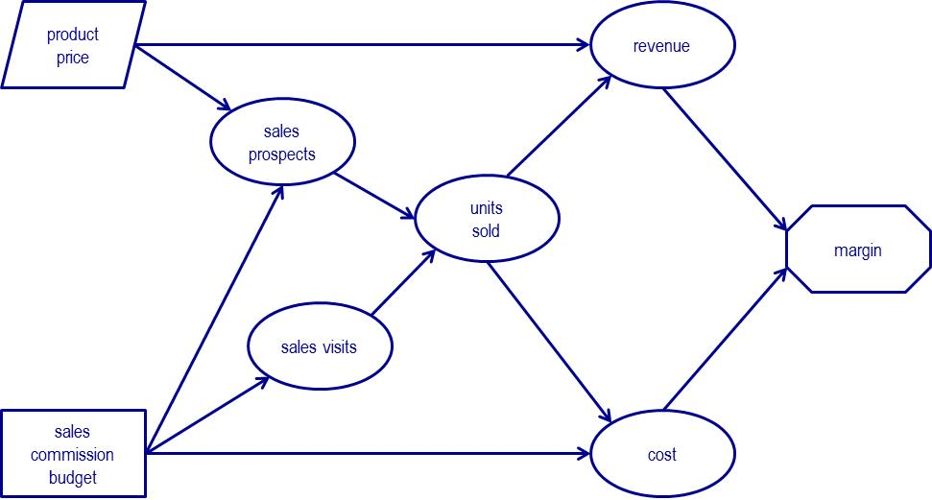
Influence Diagramming Use
Variables
to be Calculated
Influence Lines Show
Relationships to be defined as
Rules
Formulae
Algorithms
Discover Key Variables and Relationships
to Specify the Analytics Problem
Variables
to be Input

Slide 22
Stakeholder and Analytics Teams

Slide 23


Stakeholder and Analytics Teams
Data Analyst
Analytics Team Key Roles
Generate Value from Analytics
Collaborative
Virtual Structure
Based on Trust
Cross Functional
Analytics Modeller
Domain Expert
Business Analyst
Decision Maker
Suppliers
Customers
Stakeholder Groups
Benefit from Value Generated
Transparent
Based on Trust
Regulators
Shareholders
Other Functional
Departments
Leadership Teams

Slide 24
Data Characteristics

Slide 25
Data Characteristics
Data exists in a wide range of diverse formats and structures.
The ability to analyse data, requires a common foundation of key characteristics of it in order that an integrated view is available.
Data will be acquired from many different disparate sources, technologies and processes. A common foundation is needed to facilitate the analysis
Think of data characteristics as different properties possessed by a data set that must be managed to provide a uniform and integrated view
This section introduces some key characteristics of data that make it challenging to provide the necessary uniform view.

Slide 26
Data Characteristics
The following characteristics are described in this section.
Structure
Usage
Data Type
Latency
Restrictions and opportunities for the Analytics Problem
Movement
Quality
Security

Slide 27
Data Structure
Structure
Describes how the data content is organized.
Structured data describes content that individual fields are organized in a tabular style
Unstructured data describes content where the content organization is not at a field level
It generally unknown.
The structure must be discovered before analytics can play a role
Multi-structured data describes content where data has known but diverse organizations
Combinations of structured and unstructured may exist

Slide 28
Data Usage
Usage
Data usage puts context around the roles that data elements play in helping to create the information used to answer question that were framed in the Business Problem Defintion.
Facts
An answer to a question is a “fact”. The fact is a data element that may be quantitative or qualitative depending on the question.
Example:
Who is my largest customer?
The answer to this question is a customer name. It is qualitative
How many customers are in my “high value segment”?
The answer to this question is a customer count. It is quantitative.
Qualifiers
Additional data elements are qualifiers found in a business question. They provide context and grouping criteria for the fact.
Example
How many customers exist by sales region, by product, by month? The fact is customer count and the qualifiers are sales region, product and month.

Slide 29
Data Type
Type
Data type refers to how data is stored and it defines the types of processing that are supported. Common examples of data types include:
Fixed Character Strings
Variable Length Character Strings
Floating Point
Integers
Binary Values
Date
Binary Large Objects (BLOBS)
Refer to the following link for more details about data types
http://webhelp.esri.com/arcgisdesktop/9.2/index.cfm?TopicName=Geodatabase_field_data_types

Slide 30
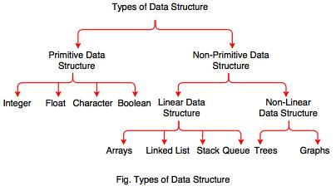
Data Structure
In computer science, a data structure is a particular way of organizing and storing data in a computer so that it can be accessed and modified efficiently. More precisely, a data structure is a collection of data values, the relationships among them, and the functions or operations that can be applied to the data.

Slide 31
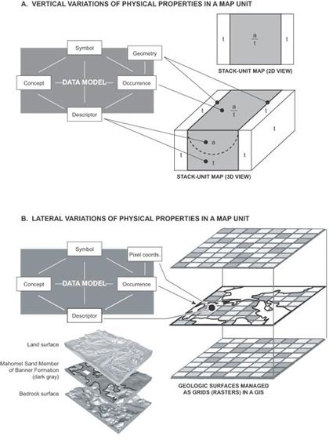
Data Model
A data model describes the structure of the data within a given domain and, by implication, the underlying structure of that domain itself.
A data model represents classes of entities (kinds of things) about which a company wishes to hold information, the attributes of that information, and relationships among those entities and (often implicit) relationships among those attributes.
The model describes the organization of the data to some extent irrespective of how data might be represented in a computer system.

Slide 32
Data Latency
Latency
Latency refers to a time perspective of data. It describes how frequently it is updated and how much of a time delay exists between an actual event happening and the related data base is made aware of it.
Real Time
low latency describes the condition when there is a “small” amount of time between a real event and the data is updated to reflect it. Depending on the application, low latency may be sub second in an automation environment and several minutes in a business environment.
Right Time
the latency in the data adequately reflects the requirements of the decision maker
Near Time
refers to the latency that is less than a day but greater than an hour.
high latency describes the condition when the delay is larger and typically measured in hours or days.

Slide 33
Data Movement
Movement
Data movement is an important concept to understand because it restricts the types of analysis that can be supported. It is related to latency but it also refers to having historical data available that may be necessary for some analytical applications.
At Rest
Data that is stored in a data platform of some kind and is waiting to be accessed is “at rest”
Data at rest is found in a data base or some other form of repository
Historical data is typically available
In Motion
Data that is flowing through an environment using messages and is never actually stored is “in motion”
Data in motion is found in a message stream also called a data pipeline.
Historical data is typically not-available

Slide 34
Data Quality
Quality
Data Quality refers to the condition when various conditions in the data sufficiently meet the requirements of those conditions by a given analytical use case
High quality data is able to meet the needs of more use cases than low quality data.
Examples of conditions of data that need to be evaluated and assessed.
Correctness Conditions – based on content
Accuracy
Completeness
Granularity
Latency
Consistency
etc
Integrity Conditions – based on structure and relationships
Unique records (no duplicates)
Parent records exist for all child records
Domain range (valid values based on defined domain set)
etc

Slide 35
Data Security
Security
Update, access and delete rules are defined based on regulations and corporate policies.
They are implemented in two categories
Authentication Rules
Validates that who you are and that you are allowed to be in the given system or application.
Authorization Rules
Define what actions you are allowed to carry out with the data given that you are on the system.

Slide 36
Quantitative Variable Types Based on Measurement Scales

Slide 37
Quantitative Variable Types
The concept of measurement and measurement scales applies to data that is quantitative and used in an Analytics Solution as part of a measurement process
Quantitative data elements are used to measure the property of something and relate its value to a standard scale based on the type of variable and its chosen units of measure
Examples of Measurement Data Used to Quantify Properties
speed of a car 100 km/hr
expected hotel service level 4 stars
size of a customer segment 1500 high value customers
current outdoor temperature 55 deg C

Slide 38
Describing Measurement Scales
Variable Type Based on Measurement Scales | Description | Example
Ratio | Whole numbers including fractional values. The “zero” position on the ratio scale is meaningful as the “absence” of something | Comparing A which is $10 to B which is $5 we can conclude 2 things A is five units bigger than B (delta) A is twice as large as B (proportion)
Interval | Whole numbers including fractional values. The “zero” position is arbitrary and does not mean the “absence” of something. | Compare two temperature readings. A is 20 Deg C and B is 10 Deg C. We can only conclude that A is 20 deg warmer than B. It is incorrect to conclude the proportion between A and B
Ordinal | Integer numbers used to rate some thing in order from best to worst. | A ranked list of hotels rated by the Star system provides a list of best to worst hotels based on service levels. The only valid conclusion is that a “4 star” hotel is better than a “2 star” hotel but you cannot infer how much better
Nominal | By aggregating individual counts into a higher level total provides a nominal measure of size of the importance of a given category | Assume a company has 3 categories of risk for their equipment. They are Low, Medium and High. Nominal variables show the count of equipment in each category. Number of equipment items in each category Low Risk = 100 units Medium Risk = 250 units High Risk = 50 units

Slide 39
Data Visualization Basics

Slide 40
What is Information Visualization?
“Transformation of the symbolic into the geometric”
(McCormick et al., 1987)
“... finding the artificial memory that best supports our natural means of perception.''
(Bertin, 1983)
The depiction of information using spatial or graphical representations, to facilitate comparison, pattern recognition, change detection, and other cognitive skills by making use of the visual system.

Slide 41
Information Visualization
Problem
Big datasets: How to understand them?
Solution
Take better advantage of human perceptual system
Convert information into a graphical representation.
Issues
How to convert abstract information into graphical form?
Do visualizations do a better job than other methods?

Slide 42
Goals of Information Visualization
More specifically, visualization should:
Make large datasets coherent
(Present huge amounts of information compactly)
Present information from various viewpoints
Present information at several levels of detail
(from overviews to fine structure)
Support visual comparisons
Tell stories about the data

Slide 43
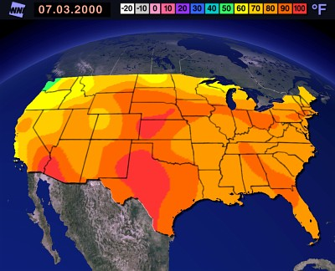
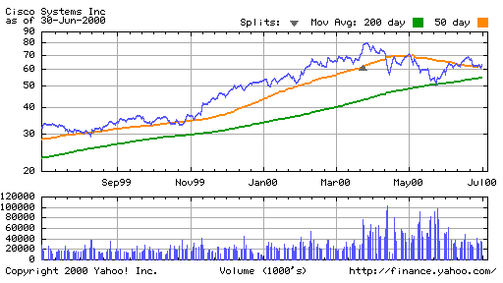
Visualization Success Stories
yahoo.com

Slide 44
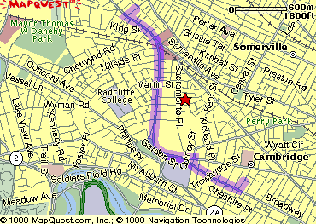
The Power of Visualization
1. Start out going Southwest on ELLSWORTH AVE
Towards BROADWAY by turning right.
2: Turn RIGHT onto BROADWAY.
3. Turn RIGHT onto QUINCY ST.
4. Turn LEFT onto CAMBRIDGE ST.
5. Turn SLIGHT RIGHT onto MASSACHUSETTS AVE.
6. Turn RIGHT onto RUSSELL ST.

Slide 45
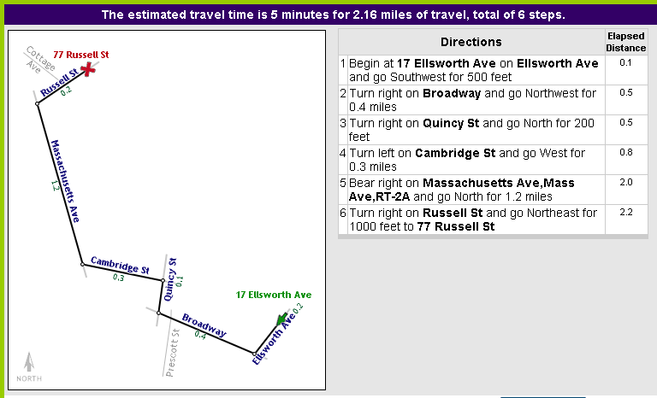
The Power of Visualization

Slide 46
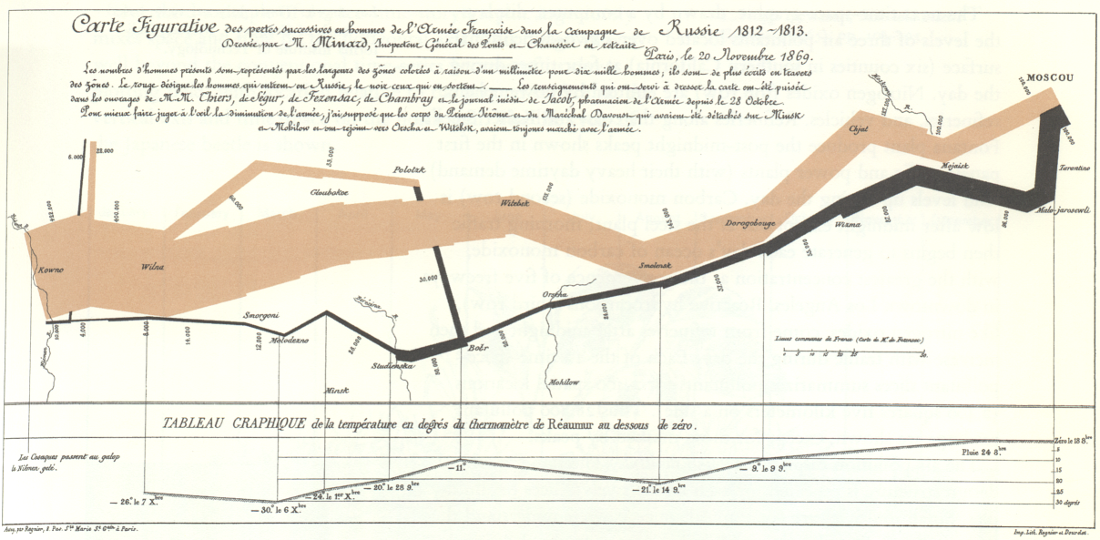
Napoleon’s 1812 March by Charles Joseph Minard
[Tufte]
Variables shown:
size of army
direction
temperature
date
latitude
longitude

Slide 47
NYC Weather
2220 numbers
[Tufte]

Slide 48
Visualization Success Story
Mystery: what is causing a cholera epidemic in London in 1854?

Slide 49
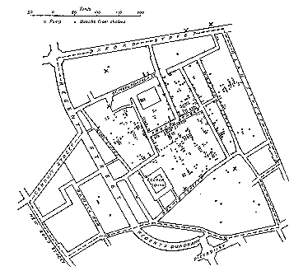
Visualization Success Story
Illustration of John Snow’s
deduction that a cholera epidemic
was caused by a bad water pump, circa 1854.
Horizontal lines indicate locations of deaths.
[Tufte]

Slide 50
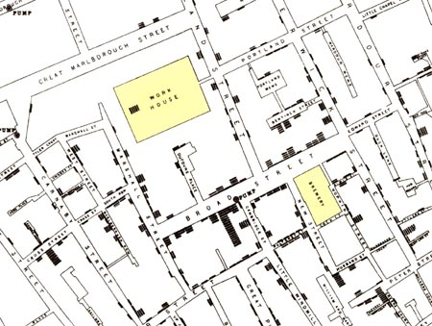
Visualization Success Story
[Tufte]

Slide 51
Data Visualization
Become acquainted with basic data visualization concepts by starting off with two videos from the Ted Talks series
https://www.ted.com/talks/hans_rosling_at_state
https://www.ted.com/talks/david_mccandless_the_beauty_of_data_visualization
Get introduced to creating visualizations using Python on the following website
https://www.datasciencecentral.com/group/tutorials/forum/topics/cheat-sheet-data-visualisation-in-python

Slide 52
Data Visualization
Read the following about the concepts related data visualization.
Become familiar with the following online resource that provides broad range of visualisation techniques on the following. Browse the site and explore how it can provide you with interesting approaches for visualising your data.
https://datavizcatalogue.com/
Read the following online resource. It provides you with a useful perspective on how to select an appropriate visualisation technique for your application.
https://blog.hubspot.com/marketing/data-visualization-choosing-chart

Slide 53
Lesson Review

Slide 54
Lesson Review
Consider the following questions that you should be able to answer by completing Day 2.
What are the main items found in a framed business problem?
What are the main items found in a defined analytics problem?
What is the purpose of an influence diagram?
What are the critical roles found in an analytics team?
What does data granularity refer to?
What are the different types of data latency?
What are some examples of ordinal data?
What are some restrictions placed on interval and ordinal data?
What criteria could you use when selecting a visualization?
What are the main building blocks of a SQL Select statement?

Slide 55
Lesson Summary

Slide 56
Lesson 2 Summary
During Day 2 you learned to:
Translate a business problem into an analytics problem statement that defines purpose, scope and requirements of a proposed analytical model.
Describe a proposed solution to the analytics problem statement in terms of stakeholders and team management.
Further differentiate Big Data from Small Data in terms of key characteristics including structure, format, granularity, latency and security requirements
Describe different types of variables encountered in measurement
Describe some basic concepts about data visualizations
Describe the basics of a SQL query
Apply and use a Python Jupyter Notebook

